Slide 1
Palliative Care in ESRD
S. Iqbal
2020

Slide 2
Objectives
Prevalence of ESRD
ESRD and age
Survival of ESRD
ESRD without dialysis or withdrawal
Symptoms at end of life
Pain Management
Best approach
Instruments to measure “GOOD Quality DEATH”

Slide 3
Prevalent ESKD by age
2018 412 65.1 5,602 575.2 16,088 2,058.0 10,149 3,688.8 8,038 3,964.2 40,289 1,405.3

Slide 4
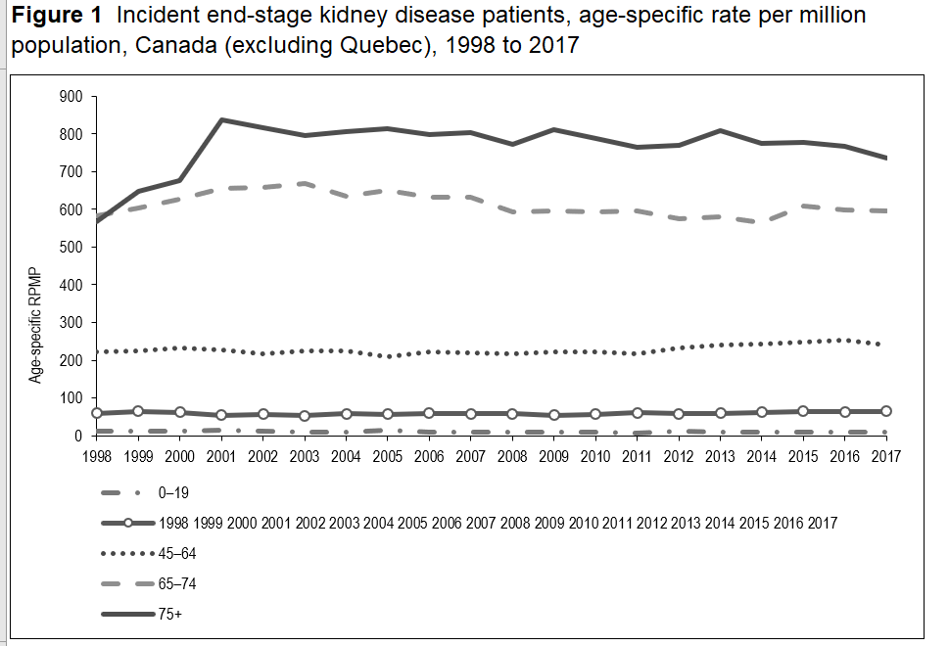
Incident ESRD and age

Slide 5
Survival dialysis 2006-2017

Slide 6
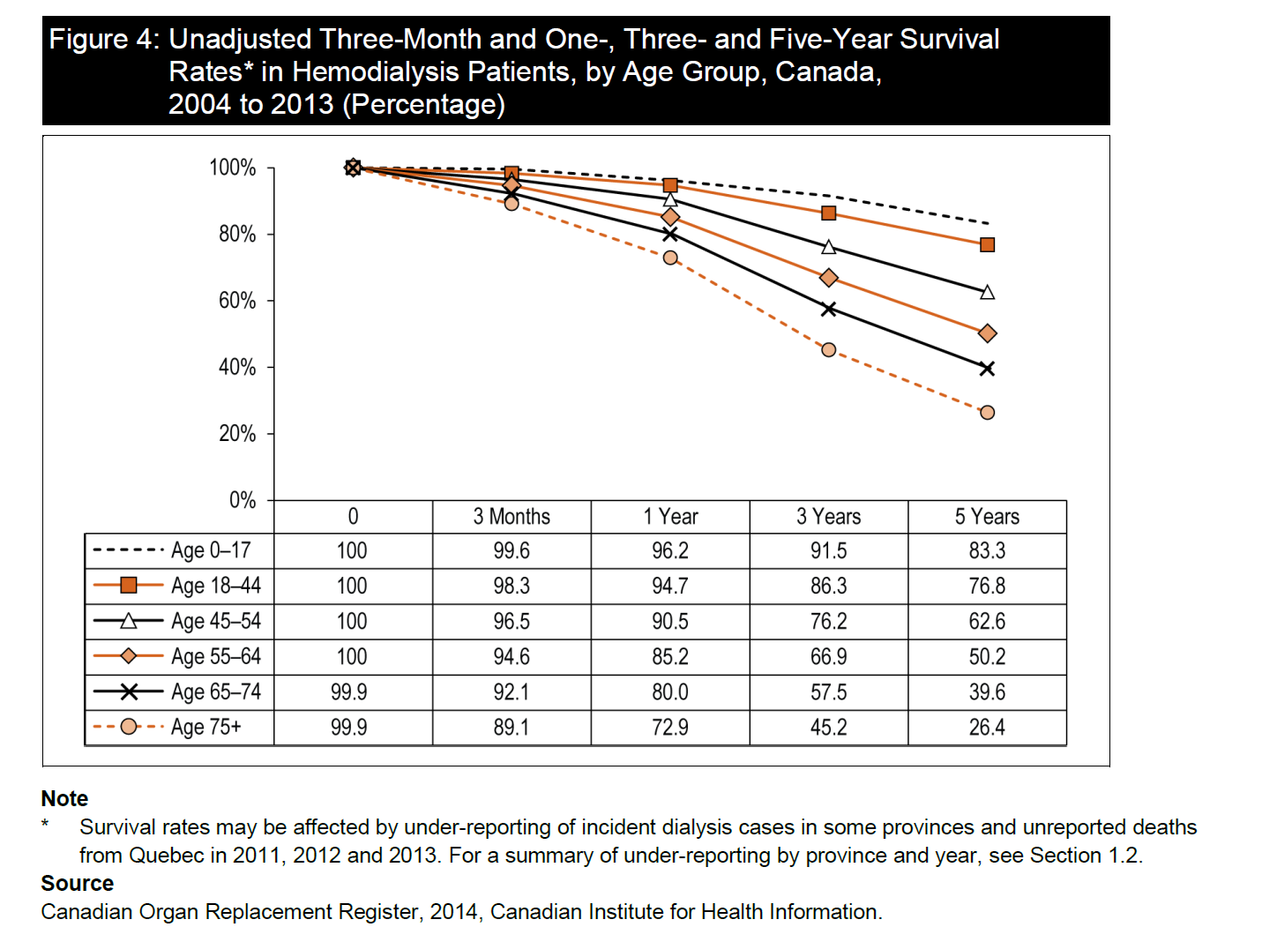
HD unadjusted Survival

Slide 7
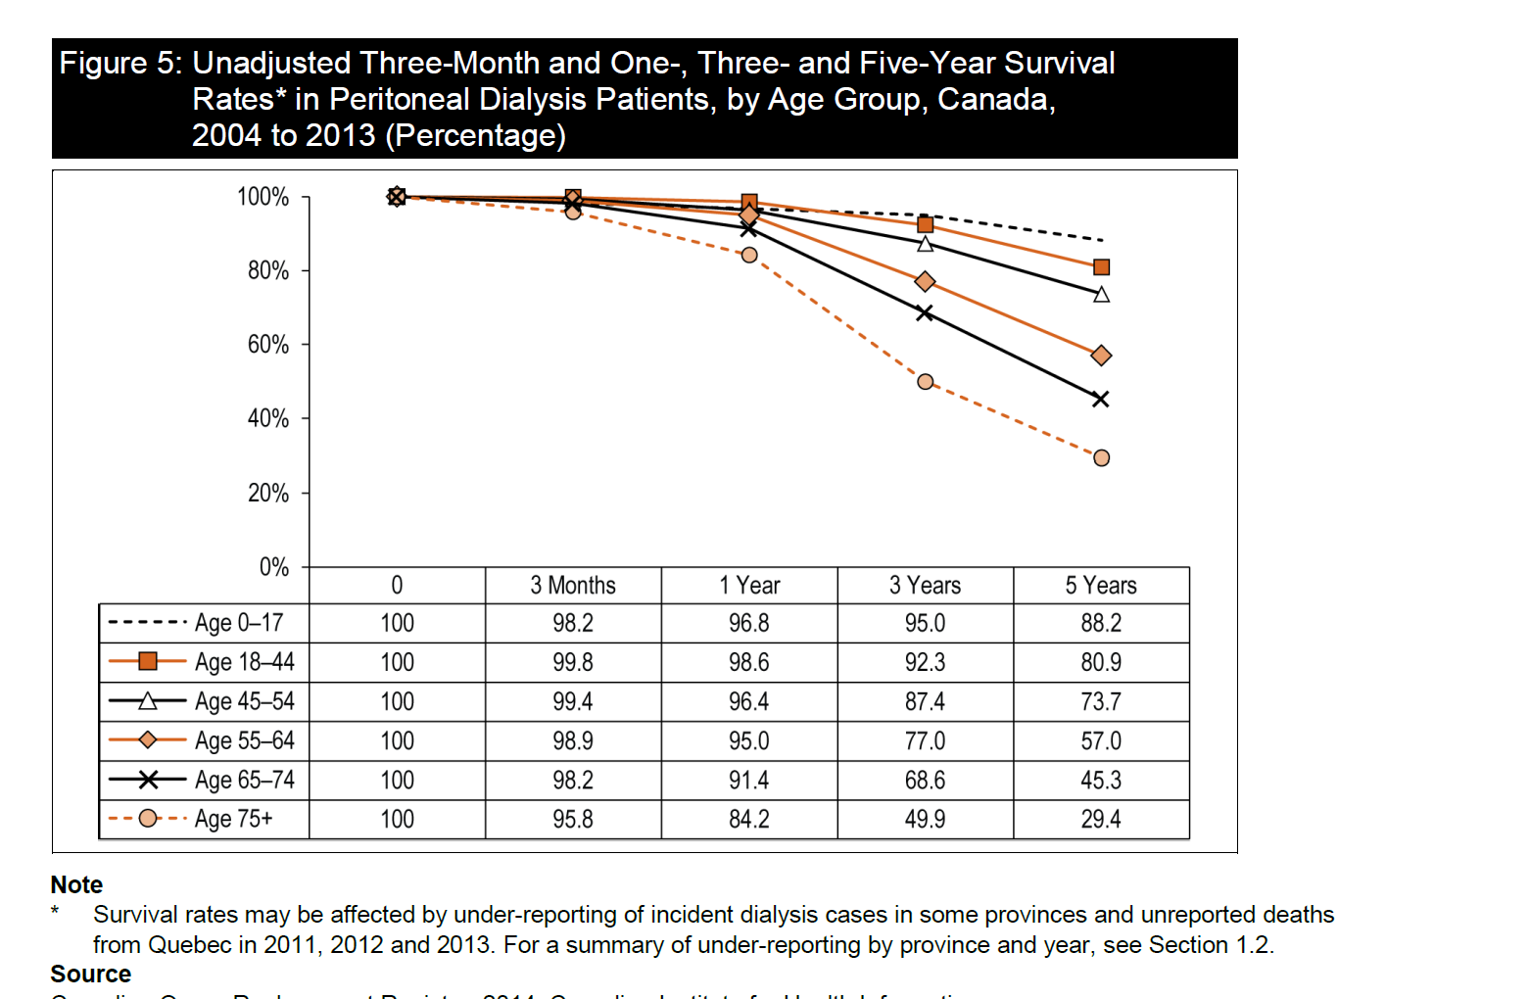
PD unadjusted Survival

Slide 8
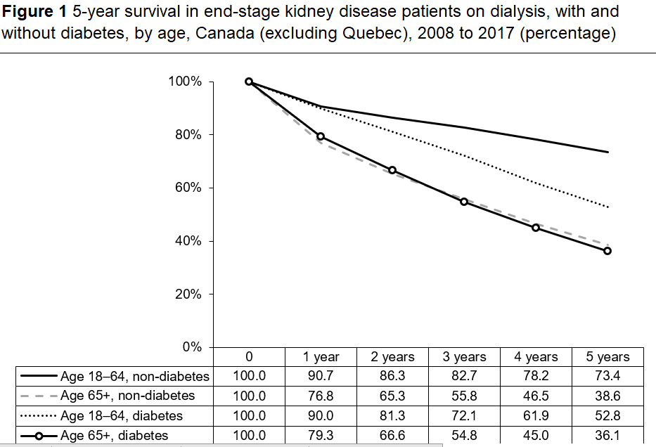
Mortality of ESRD 2017

Slide 9
Mortality
Crude mortality 18-20%/year
Adjusted mortality about 15% per year
CORR reports most common cause of death is Cardiovascular, Miscellaneous and Infections

Slide 10
Chen JC, Thorsteinsdottir B, Vaughan LE, et al. End of Life, Withdrawal, and Palliative Care Utilization among Patients Receiving Maintenance Hemodialysis Therapy. Clin J Am Soc Nephrol. 2018;13(8):1172‐1179.
Reasons on withdrawal from dialysis among US patients
Cardiac disease, lung disease, malignancy, multiple comorbidities
Observational data from US, 2001-2015, n=1226 (49% withdrew)
Notes:
Reasons on withdrawal from dialysis among US patients
Cardiac disease, lung disease, malignancy, multiple comorbidities

Slide 11
Serum Albumin
Lowrie, 1990
As serum albumin levels decrease, the relative risk of mortality increases

Slide 12
Functional Status
Among 10,3335 hemodialysis and pd patients in McCellan, 1994
As functional status decreases, mortality risk increases

Slide 13
Cohen et al, Predicting Mortality For Patients Who are on Maintenance Hemodialysis CJASN 2010
Predictive models for risk of mortality in the elderly: Age, dementia, PVD, Serum albumin, surprise Question.

Slide 14
Model to predict risk of mortality on hemodialysis
Highest hazard ratios were with with surprise question and dementia

Slide 15
Surprise question alone
Trinary (Yes/No/Neutral) sens 55 % and spec 76%
Binary (Yes/No) sens 66% and spec 68%
Alone the question is not useful, best used with other tools.

Slide 16
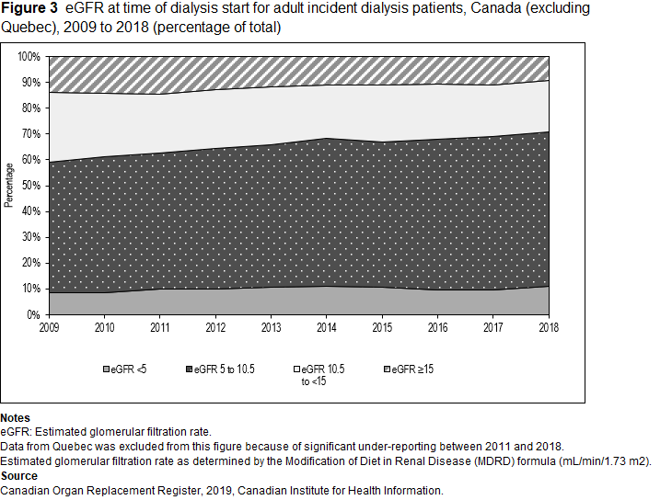

Slide 17
Early starts and signs/symptoms ass.
Weight gain 3.8 percent, dyspnea resolved vs persistent, new edema,
Persistent edema, cognitive decline, increasing adl dependence,
weight loss >5.75 of body weight
Signs and symptoms associated with earlier dialysis initiation in nursing home residents. Kurella Tamura M - Am J Kidney Dis - 01-DEC-2010; 56(6): 1117-26

Slide 18
Maddalena V, O'Shea F, Barrett B. An Exploration of Palliative Care Needs of People With End-Stage Renal Disease on Dialysis: Family Caregiver's Perspectives. J Palliat Care. 2018;33(1):19‐25.
List of important symptoms

Slide 19
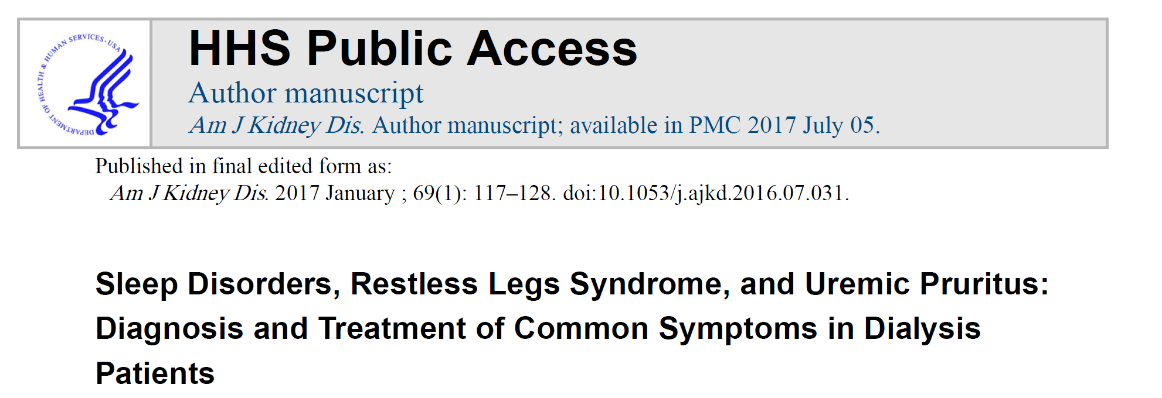
Symptom prevalence in CKD
Uremic pruritis, anorexia, pain, and sleep disorders are the most prevalent symptoms
No difference in conservative management patients and dialysis patients in the
frequency of common symptoms

Slide 20
When to consider palliation
Readmission from long term care facilities
Frequency of admissions in a set time (3 or more in a month)
Advanced and metastatic cancer
Difficult symptom management
Critically ill without advance directives
Finn L, Malhotra S. The Development of Pathways in Palliative Medicine: Definition, Models, Cost and Quality Impact. Healthcare (Basel). 2019;7(1):22.

Slide 21
Hospitalization, emergency visits, ICU care increased during
Last months of life
Medicare data: age over 65, between 2004-2007

Slide 22
Highest proportion of admission in hospital is in the last 3 weeks of life

Slide 23
Sellars M, Clayton JM, Detering KM, Tong A, Power D, Morton RL. Costs and outcomes of advance care planning and end-of-life care for older adults with end-stage kidney disease: A person-centred decision analysis. PLoS One. 2019;14(5):e0217787.
More expensive to start someone on dialysis and withdraw then not start someone on dialysis and those that die prior to withdrawal

Slide 24
ESRD with no dialysis
Do not start/ withdraw
When do we do dialysis:
eGFR less than 10ml/min/1.73m²
Electrolyte disorders (hyperkalemia)
Fluid overload
Pleuritis/pericarditis
Uremic encephalopathy
Metabolic acidosis
High serum Phosphate levels/high PTH levels

Slide 25
Survival with conservative management (never start dialysis) vs dialysis
Range 6-23 months for over median age 75 with CM
Range 8-38 months for over median age 75 with dialysis
(one outlier survival was 67 months)
Conservative Management of End-Stage Renal Disease without Dialysis: A Systematic Review
Nina R. O’Connor, M.D.1 and Pallavi Kumar, M.D
Journal of Palliative Medicine Nov 2012

Slide 26
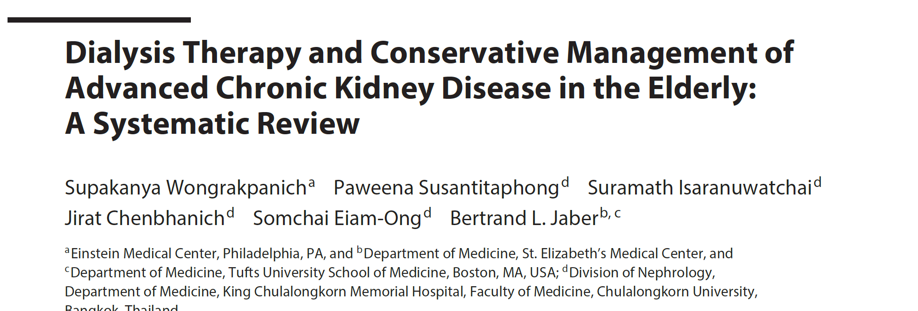
Age over 65, 12 studies reviewed
Dialysis Median survival 8-67 months
Conservative Median survival 6-30 months

Slide 27
Catalano et al NDT 1996
UK study 1996
After dialysis withdrawal of 88 patients (17% of all mortality) the median survival was 8 (0-35) days, 15 patients survived 3 days or less and 19 more than 10 days.

Slide 28
Four domains of care
1. pain and symptom assessment and management
2. The communication between health care teams and patients and/or family goals of care and advanced medical decision making
3. Provision and support of patients and/or families and health care teams
4. End of life care, comfort care and hospice services
Finn L, Malhotra S. The Development of Pathways in Palliative Medicine: Definition, Models, Cost and Quality Impact. Healthcare (Basel). 2019;7(1):22.

Slide 29
Suffering
Physical
Emotional
Psychosocial
Spiritual

Slide 30
Symptoms at end of life
Chronic pain, nausea, delirium, agitation, dyspnea, pruritis
Symptoms in the Month Before Death
for Stage 5 Chronic Kidney Disease Patients
Managed Without Dialysis
Fliss E. Murtagh, PhD, MRCGP, MSc, Julia Addington-Hall, BA, PhD,
Polly Edmonds, FRCP, Paul Donohoe, FRCP, PhD, Irene Carey, MRCPI, MSc,
Karen Jenkins, RN, PG Dip HE, and Irene J. Higginson,

Slide 31
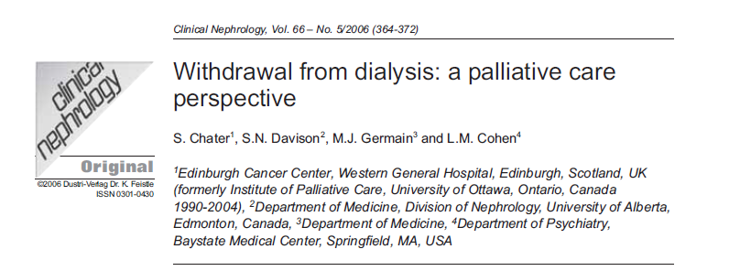
Symptoms noted before and after palliative care involvement

Slide 32
Causes of Pain
Neuropathic
Peripheral neuropathy, ischemia, phantom limb, carpal tunnel syndrome, calciphylaxis, renal osteodystrophy, steal syndrome from access, osteoarthritis, amyloidosis
Opioids do not treat this kind of pain well
Gabapentin

Slide 33
Hydromorphone
Binds to opioid receptors in CNS, inhibits ascending pain pathways, altering the perception of and response to pain (uptodate)
Metabolized by the liver but the metabolites remain longer due to renal impairment
Start dose 25-50% lower than those with normal renal function
Sq 0.5mg q4h and slowly increase (opioid naïve)

Slide 34
Neurotoxicity
High doses of opioids lead to myoclonus, seizures, CNS depression and death
Use with caution

Slide 35
Fentanyl patch
Use only once on opioids beforehand
Again dose is started at 50% less than someone with normal renal function
Metabolized by the liver CYP3A4
High volume of distribution and lipophilic
Once discontinued, would still remain in body longer
Accumulates with chronic use

Slide 36
Methadone
Binds to opioid receptors in the CNS
Weak antagonist for N-methyl-D-aspartate
Less tolerance and neurotoxicity
10% excreted through urine, rest through feces
With renal failure, higher levels
Start low dose and increase

Slide 37
Meperidine
Demerol/meperidine
Metabolite causes neurotoxicity
Seizures/death
Never use in renal patients

Slide 38
Gabapentin
Gabapentin is an analog of gamma-aminobutyric acid (GABA) that has GABA agonist activity.
Mechanism of action: unknown
Renal excretion
Long half life in renal patients
Dose small and go up
100mg daily and titrate up to 600mg/day
Sedation, tremor, ataxia as side effects

Slide 39
Preferred treatment for pain
Good table to refer to from this article
Clin J Am Soc Nephrol 7: 2049–2057, December, 2012 End-of-Life Care in ESRD Patients, Davison

Slide 40
Conservative measures for pain
Exercise
Massage
Acupuncture
Hot/cold therapy
Meditation
Distraction
Music therapy
Cognitivie behavioural therapy
Raina, R., Krishnappa, V. and Gupta, M. (2018), Management of pain in end‐stage renal disease patients: Short review. Hemodialysis International, 22: 290-296

Slide 41
Dyspnea
Oxygen
Positioning/open window/fan
Opioids
Diuretics if they still urinate
Sedatives: benzodiazepine

Slide 42
Midazolam
Has higher potency then other benzodiazepines, shorter half life and less cardiorespiratory depression
Subcutaneous is 1/3 as potent as iv
In patients with eGFR below 10 ml/min/1.73 m² use 50% reduction in dosing
Start low and go up 0.5mg q2h prn for results
Sedates: use cautiously

Slide 43
Nausea
Maxeran/metoclopromide: dopaminergic blocking agent, GI stimulant

Slide 44
Agitation/anxiety
Risperidone 0.25mg bid po
Haloperidol 0.5mg to 1mg to settle down iv/im
Terminal: Benzodiazepines (midazolam)

Slide 45
pruritis
UV B light
Emollients and moisturizing creams
Thalidomide
Mirtazipine
Gabapetin

Slide 46
Nephron 1994: Silva et al
29 refractory pruritis cases in hemodialysis
55% reduction of symptoms in a crossover study with thalidomide
Thalidomide dose 100mg per day
Very small amount cleared by the kidneys
No side effects were reported

Slide 47
Mirtazapine
H1, 5HT2 and 5HT3 receptor blocker
SSRI, antidepressant
Case series published in 2003, 7.5-15 mg daily was used in renal failure for pruritis and was successful

Slide 48
ESA
Erythropoeitin stimulating agents
Stimulate bone marrow to produce RBCs
Stopping this drug often will lead to worsening fatigue, due to anemia
Controversial whether to continue during the last days

Slide 49
Death
Occurs due to
hyperkalemia
Pulmonary edema and cardiorespiratory failure

Slide 50
Summarize RPA/ASN guidelines 2010
Establishing a Shared Decision-Making Relationship
Recommendation No. 1
Develop a physician-patient relationship for shared decision-making.
Informing Patients
Recommendation No. 2
Fully inform AKI, stage 4 and 5 CKD, and ESRD patients about their diagnosis,
prognosis, and all treatment options.
Recommendation No. 3
Give all patients with AKI, stage 5 CKD, or ESRD an estimate of prognosis specific to
their overall condition.
Facilitating Advance Care Planning
Recommendation No. 4
Institute advance care planning.
Making a Decision to Not Initiate or to Discontinue Dialysis

Slide 51
Making a Decision to Not Initiate or to Discontinue Dialysis
Recommendation No. 5*
If appropriate, forgo (withhold initiating or withdraw ongoing) dialysis for patients
with AKI, CKD, or ESRD in certain, well-defined situations.
These situations include the following:
• Patients with decision-making capacity, who being fully informed and making
voluntary choices, refuse dialysis or request that dialysis be discontinued.
• Patients who no longer possess decision-making capacity who have previously
indicated refusal of dialysis in an oral or written advance directive.
• Patients who no longer possess decision-making capacity and whose properly
appointed legal agents/surrogates refuse dialysis or request that it be discontinued.
• Patients with irreversible, profound neurological impairment such that they lack signs
of thought, sensation, purposeful behavior, and awareness of self and environment.
*Medical management incorporating palliative care is an integral part of the decision to
forgo dialysis in AKI, CKD, or ESRD, and attention to patient comfort and quality of life
while dying should be addressed directly or managed by palliative care consultation and
referral to a hospice program

Slide 52
Recommendation No. 6
Consider forgoing dialysis for AKI, CKD, or ESRD patients who have a very poor
prognosis or for whom dialysis cannot be provided safely.
Included in these categories of patients are the following:
Those whose medical condition precludes the technical process of dialysis because
the patient is unable to cooperate (e.g., advanced dementia patient who pulls out
dialysis needles) or because the patient’s condition is too unstable (e.g., profound
hypotension).
Those who have a terminal illness from non-renal causes (acknowledging that some
in this condition may perceive benefit from and choose to undergo dialysis).
Those with stage 5 CKD older than age 75 years who meet two or more of the
following statistically significant very poor prognosis criteria (see
Recommendations No. 2 and 3): 1) clinicians’ response of “No, I would not be
surprised” to the “surprise” question; 2) high comorbidity score; 3) significantly
impaired functional status (e.g., Karnofsky Performance Status score less than 40);
and 4) severe chronic malnutrition (i.e., serum albumin less than 2.5 g/dL using the
bromcresol green method).

Slide 53
Prognostic tools
Karnofsky performance status
Nutritional status

Slide 55
Resolving Conflicts about What Dialysis Decisions to Make
Recommendation No. 7
Consider a time-limited trial of dialysis for patients requiring dialysis, but who have an uncertain prognosis, or for whom a consensus cannot be reached about providing dialysis.
Recommendation No. 8
Establish a systematic due process approach for conflict resolution if there is disagreement about what decision should be made with regard to dialysis.

Slide 56
Providing Effective Palliative Care
Recommendation No. 9
To improve patient-centered outcomes, offer palliative care services an d interventions to all AKI, CKD, and ESRD patients who suffer from burdens of their disease.
Recommendation No. 10
Use a systematic approach to communicate about diagnosis, prognosis, treatment options, and goals of care.

Slide 57
Suffering
No planned site to take when unable to keep at home
Family felt not relieving his symptoms of respiratory distress
Acute care bed not a place for good palliation
Family upset for months after

Slide 58
Instruments to measure quality of death
Edmonton symptom assessment system and Memorial symptom assessment scale renamed as dialysis symptom index (symptom assessment tool) been validated in CKD population
Quality of dying and death questionnaire closest to achieving the domains mentioned

Slide 59
Standardized Palliative care orders
For fever or pain
Acetaminophen 500mg po or per rectum q6h prn
Hydromorphone 0.5mg sq q6h prn
For pruritis
hydroxyzine12.5-25 mg po or im q8h prn
Isoptotears 0.5% i per each eye q 2h prn
Change position in bed q 2h prn
Waffle mattress or special mattress to avoid bed sores
Moisturize mouth with sponge q2 h prn
For dyspnea: midazolam 0.5-1.0 mg sq q 1-2 hour prn
Ventilation mask oxygen 28% with humidification device, prn
Glycerine supp pr one daily prn
Copyright Dr. Sameena Iqbal

Slide 60
Take home messages
More involvement of palliative care services for ESRD population do not choose dialysis or continue dialysis
Physical: pain, agitation, dyspnea, pruritis
Use medications with caution in renal disease, small doses and titrate up
Aim for a good quality death
Advocate for more resources on this

